Slide 1
FINE ARTS
PAINTING : CODE NO - 049
Class - XI

Slide 2
PAINTING
Class - XI
Total Marks: 100
Practical: 60 Marks
Theory: 40 Marks

Slide 3
PAINTING
Practical : 60 Marks
Unit: 1 20 Marks
Unit: 2 20 Marks
Unit: 3 20 Marks
Total : 60 Marks

Slide 4
PAINTING
Practical contents:
Unit: 1 20 Marks
1. Nature Study
2. Object Study
Students have to submit Three (3) works in entire year.

Slide 5
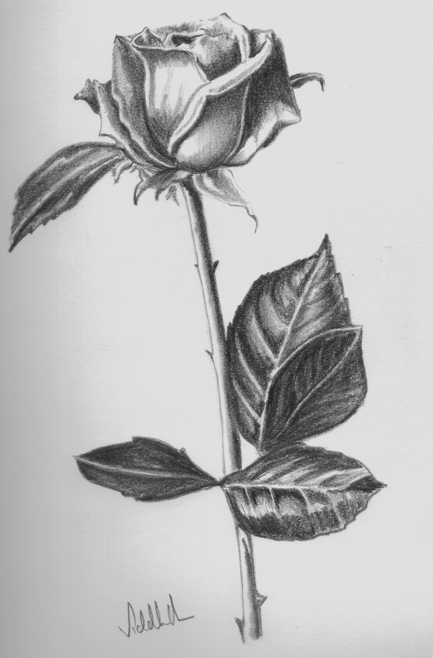
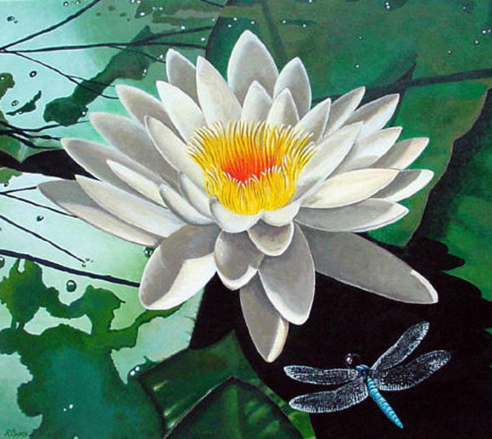
PAINTING
1. Nature Study

Slide 6
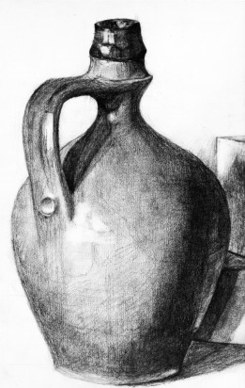
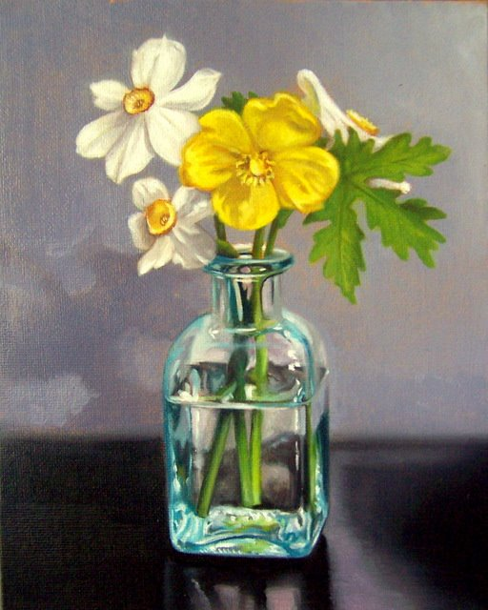
PAINTING
2. Object Study

Slide 7
PAINTING
Practical contents:
Unit: 2 20 Marks
Painting Composition
Students have to submit Three (3) works in entire year.

Slide 8
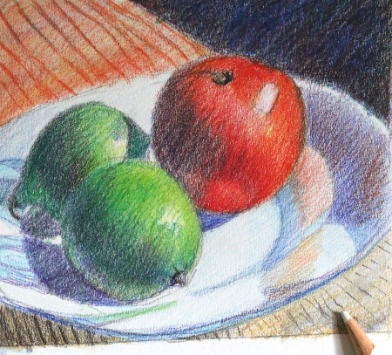
PAINTING
Painting Composition

Slide 9
PAINTING
Practical contents:
Unit: 3 20 Marks
Portfolio Assessment
Record of entire years finish work.
Seven (7) study and still life works and 2 paintings.

Slide 10
PAINTING
Theory contents:
Unit: 1 Pre-Historic rock paintings and art of Indus Valley 10 Marks
Unit: 2 Buddhist, Jain and Hindu Art 15 Marks
Unit: 3 Temple Sculptures, Bronzes and Artistic aspects of Indo – Islamic architecture 15 Marks
Total : 40 Marks

Slide 11
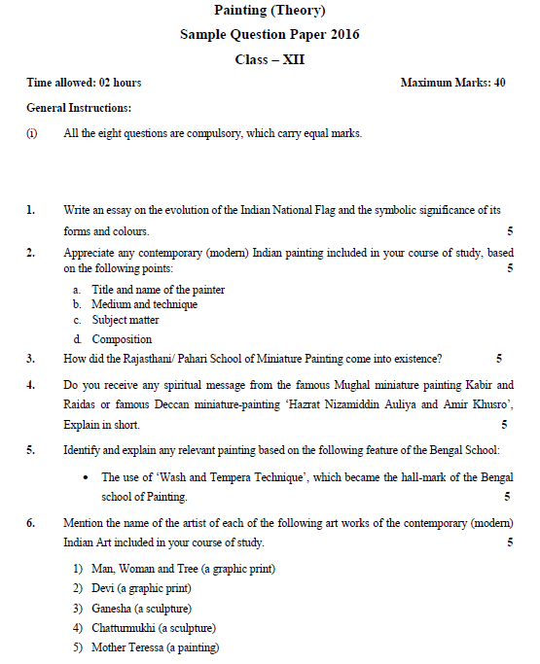
Sample Paper of Board Examination.
Page: 1

Slide 12
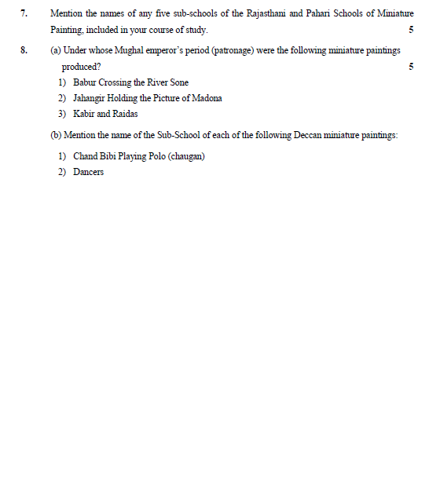
Sample Paper of Board Examination.
Page: 2

Slide 13
